Slide 1
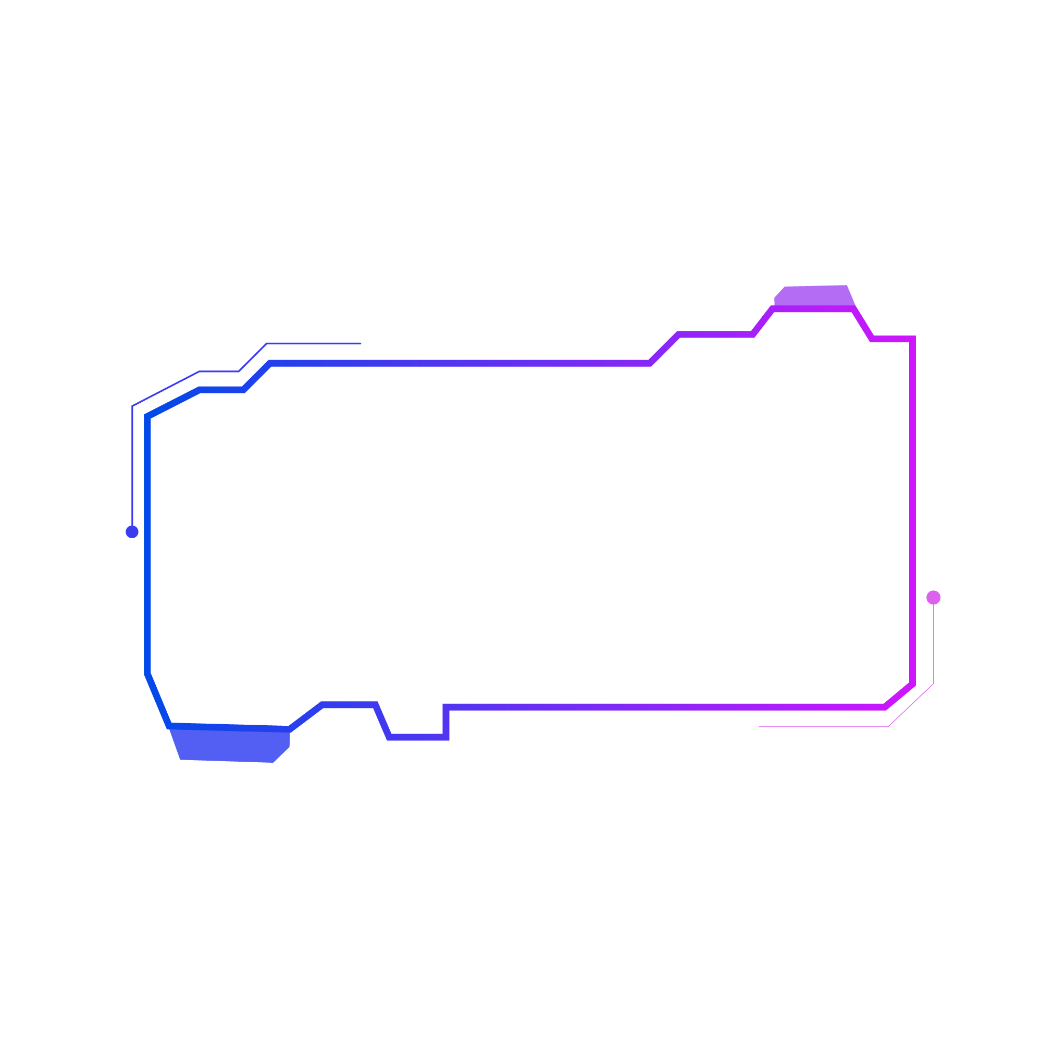


Strategic Business Information Technology
Strategic Analysis of Emerging Technology for Competitive Advantage
CA2
Charles Rocha - 2021376

Slide 2
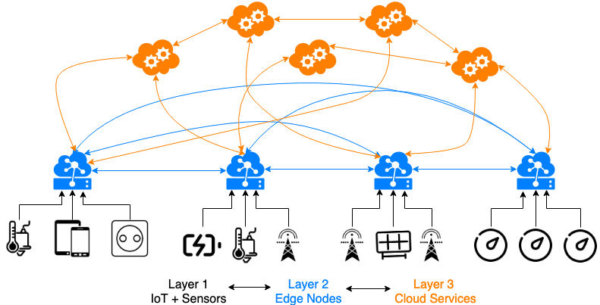
What is Edge Computing?
In few words, Edge Computing is an intermediary layer between could services and physical devices.
(Sittón-Candanedo et al., 2019)

Slide 3
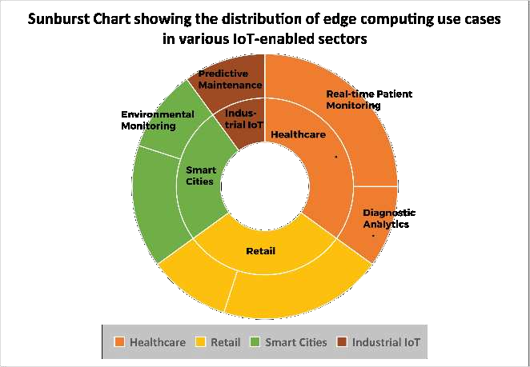
Why Edge Computing is an Emerging Technology?
Dispite some challenges, however driven by IoT, 5G, and AI advancements, Edge Computing can be used in many sectors such as Healthcare, Smart Cities, Industrial and Retail, which is the one we will take a look at.
(Rakesh Paul et al., 2024)

Slide 4


Use of Edge Computing – Amazon Go & Walmart
In retail we know:
Walmart uses edge computing for real-time inventory, energy management, and customer behavior analytics.
Amazon Go are cashier-less stores that use edge devices for real-time checkout.
(Walmartcanada.ca, 2025)
(Amazon, 2023)

Slide 5
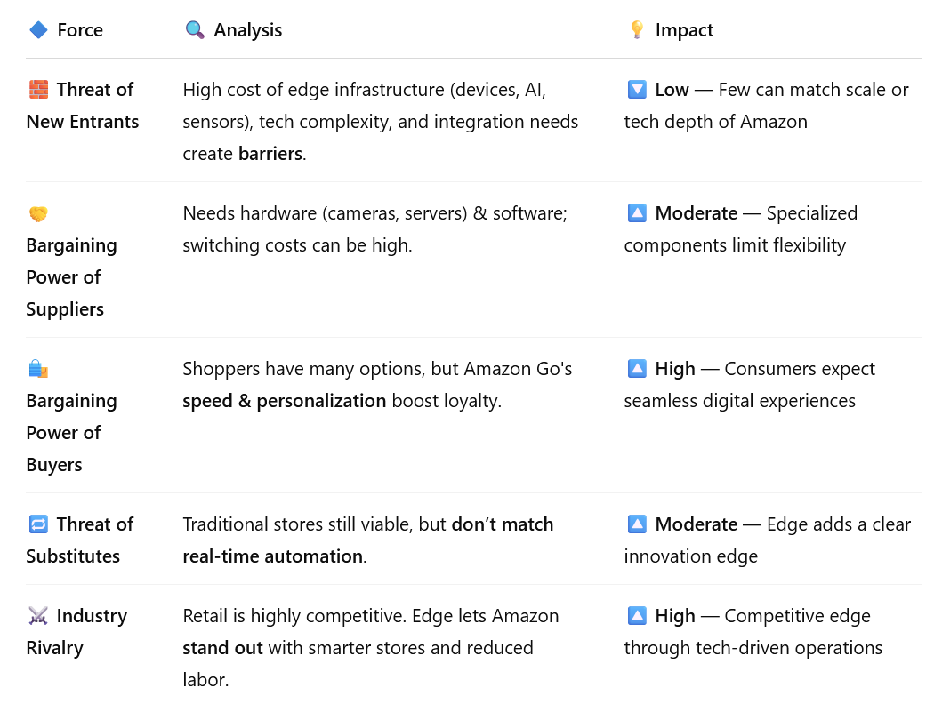
Competitive Advantage via Porter's Value Chain
Force | Analysis | Impact
Threat of New Entrants | High cost of edge infrastructure (devices, AI, sensors), tech complexity, and integration needs create barriers. | 🔽 Low — Few can match scale or tech depth of Amazon
Bargaining Power of Suppliers | Needs hardware (cameras, servers) & software; switching costs can be high. | 🔼 Moderate — Specialized components limit flexibility
Bargaining Power of Buyers | Shoppers have many options, but Amazon Go's speed & personalization boost loyalty. | 🔼 High — Consumers expect seamless digital experiences
Threat of Substitutes | Traditional stores still viable, but don’t match real-time automation. | 🔼 Moderate — Edge adds a clear innovation edge
Industry Rivalry | Retail is highly competitive. Edge lets Amazon stand out with smarter stores and reduced labor. | 🔼 High — Competitive edge through tech-driven operations

Slide 6




Challenges & Limitations: SWOT Analysis
Strengths | ⚠ Weaknesses
⚡ Real-time data processing with low latency | 💸 High infrastructure and deployment cost
🧠 Enhanced user experiences through local decision-making | 🔐 Increased security risks at multiple edge points
📶 Reduces bandwidth usage and cloud dependency | 🧩 Complex data management across distributed systems
📴 Supports offline operations, improving reliability | 📏 Challenging to scale and standardize
Opportunities | ⚡ Threats
📡 Boom in IoT, 5G, and edge-AI integration | 🛡 Cyberattacks targeting decentralized nodes
🏥 Transform industries like healthcare, retail, logistics | 🕵 Privacy and regulatory concerns (e.g., GDPR)
🏙 Enable smart cities and intelligent automation | 🚫 Lack of unified industry standards
📊 Real-time analytics for better business insights | 🧠 Skills gap in managing edge environments

Slide 7
Societal Impact of Edge Computing
Enables smarter retail experiences and automation.
Raises questions around privacy, surveillance, and data security.
Potential job displacement, but also creates tech-based job roles.

Slide 8
Future Outlook
Growth powered by 5G and edge-AI synergy.
Potential for AR-based shopping, like IKEA and Sephora, real-time analytics, robotics.
Key enabler of innovation and customer engagement in digital retail.

Slide 9
References
Alwakeel, A.M. (2025). Enhancing IoT performance in wireless and mobile networks through named data networking (NDN) and edge computing integration. Computer Networks, 264, p.111267. doi:https://doi.org/10.1016/j.comnet.2025.111267.
Amazon (2023). Amazon Go. [online] Amazon.com. Available at: https://www.amazon.com/b?ie=UTF8&node=16008589011.
Gao, Z. and Yan, W. (2025). The real-time data processing framework for blockchain and edge computing. Alexandria Engineering Journal, 120, pp.50–61. doi:https://doi.org/10.1016/j.aej.2025.01.092.
Karthikeyan P and A, M.K. (2024). Empowering the Future: The Impact of Cloud and Edge Computing on Modern Business Transformation. INTERANTIONAL JOURNAL OF SCIENTIFIC RESEARCH IN ENGINEERING AND MANAGEMENT, 08(10), pp.1–7. doi:https://doi.org/10.55041/ijsrem38035.
Rakesh Paul, Islam, M., Ankur Sarkar, Rahman, O., Tariqul Islam and Bari (2024). The Role of Edge Computing in Driving Real-time Personalized Marketing: a Data-driven Business Perspective. International Journal For Multidisciplinary Research, 6(5). doi:https://doi.org/10.36948/ijfmr.2024.v06i05.28494.

Slide 10
References
Shi, W., Cao, J., Zhang, Q., Li, Y. and Xu, L. (2019). Edge Computing: Vision and Challenges. IEEE Internet of Things Journal, 3(5), pp.637–646. doi:https://doi.org/10.1109/jiot.2016.2579198.
Sittón-Candanedo, I., Alonso, R.S., García, Ó., Muñoz, L. and Rodríguez-González, S. (2019). Edge Computing, IoT and Social Computing in Smart Energy Scenarios. Sensors, 19(15), p.3353. doi:https://doi.org/10.3390/s19153353.
Varghese, B., Wang, N., Barbhuiya, S., Kilpatrick, P. and Nikolopoulos, D.S. (2016). Challenges and Opportunities in Edge Computing. 2016 IEEE International Conference on Smart Cloud (SmartCloud). [online] doi:https://doi.org/10.1109/smartcloud.2016.18.
Varma, A., Varde, Y. and Ray, S. (2024). Reinventing the retail experience: The case of amazon GO. World Journal of Advanced Research and Reviews, [online] 21(3), pp.1123–1133. doi:https://doi.org/10.30574/wjarr.2024.21.3.0779.
Walmartcanada.ca. (2025). Walmart Canada announces landmark $6.5 billion investment in its store and supply chain footprint, announcing dozens of new stores to be built across Canada over the next five years. [online] Available at: https://www.walmartcanada.ca/news/2025/01/30/walmart-canada-announces-landmark--6-5-billion-investment-in-its.

Slide 11
THANKS

